Slide 1
Knowledge, Reasoning & Planning Logical Agents cont.
Knowledge based agents
The Wumpus World
Knowledge representation techniques
Logic
Propositional Logic

Slide 2
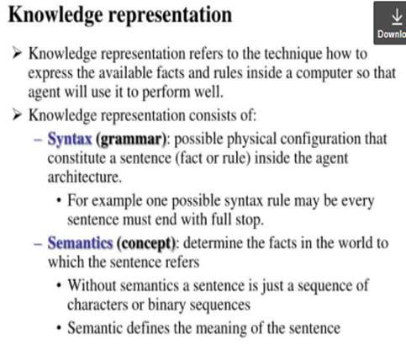
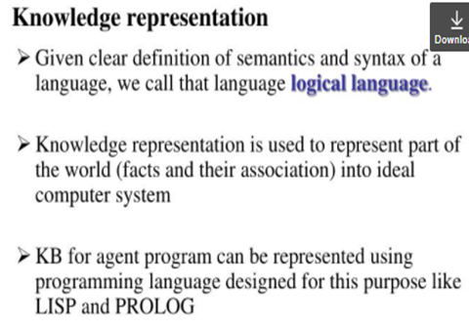
End of Previous slides

Slide 3
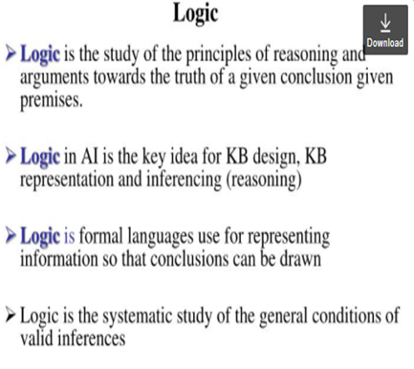
LOGIC

Slide 4
Basic Concepts of Logic
Syntax: Formal structure of sentences
Semantics: Truth of sentences based on models
Entailment: Necessary truth of one sentence given another
Entailment means that one thing follows from another:
KB ╞ α
Inference: Deriving sentences from other sentences
Soundness: Derivations produce only entailed sentences
Completeness: Derivations can produce all entailed sentences

Slide 5
TYPES OF LOGIC
In mathematics there are different kinds of logics
Some of these according to order of their generality are:
Prepositional logic
First order logic
Second order logic and more

Slide 6
Propositional Logic (Boolean)
Prepositions are statements that are either true or false but not at both any time.
A statement is a sentence which is either true or false.
PL uses declarative sentences only
PL does not involve quantifiers - (∃x) (read as “there is an individual, call it x, such that it is true of x that …”) and (∀y) (read as “for every individual, call it y, it is true of y that …”).
Not all sentences are statement (interrogative, imperative and exclamatory.

Slide 7
Propositional Logic cont.
Propositions can be conditional or unconditional.
Examples:
Socrates is mortal (unconditional)
If winter is severe, students will not succeed (conditional)
All are the same if their colour is black (conditional)
In prepositional logic, symbols represent the whole preposition.
Example:
M = Socrates is mortal
W = Winter is severe
S = Students will not succeed

Slide 8
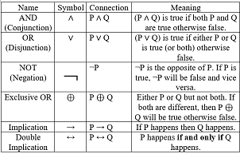
Propositional Logic cont.
Propositions can be combined using Boolean connectives to generate new proposition with complex meaning,
Symbols involved in PL:
Logical constants (TRUE and FALSE)
Proposition symbols (also called atomic symbols) like M, W, S
Logical connectives:

Slide 9
Prepositional Logic cont.
RULES
Logical constants and propositional symbols are sentences by themselves.
Wrapping parenthesis around a sentence yield a sentence like (P v R).
Literal are atomic symbols or negated atomic symbols.
Complex sentence can be formed by combining simpler sentences with logical connectors.

Slide 10
PL Connector Priority
Priority of logical connectors from HIGHEST to LOWEST
Parenthesis
Negation
Conjunction
Disjunction
Implication
Bi-implications

Slide 11
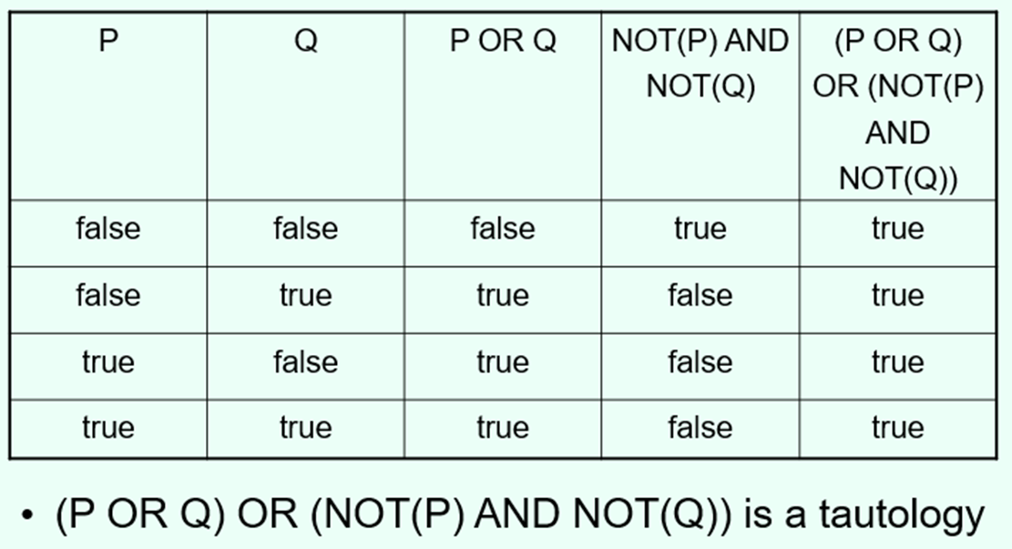
Types of sentences
Valid (tautology)
Statement that is always true. An expression involving logical variables that is true in all cases is a tautology. We use the number 1 to symbolize a tautology.
Examples:
I will either get paid or not get paid
(¬(p ∧ q)) ↔ (¬p ∨ ¬q)
p ∨ ¬p

Slide 12
Types of sentences cont.
Invalid (contradiction)
An expression involving logical variables that is false in all cases is a contradiction. We use the number 0 to symbolize a contradiction.
The following are contradictions:
(a) p ∧ ¬p
(b) (p ∨ q) ∧ (¬p) ∧ (¬q)
Satisfiable (neither valid nor invalid)
A formula is valid if it is true for all values of its terms.
Satisfiability refers to the existence of a combination of values to make the expression true.
So, in short, a proposition is satisfiable if there is at least one true result in its truth table, valid if all values it returns in the truth table are true

Slide 13
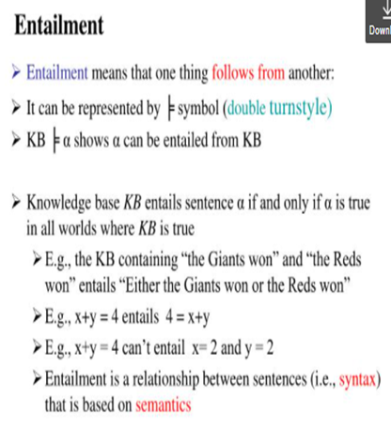

Slide 14
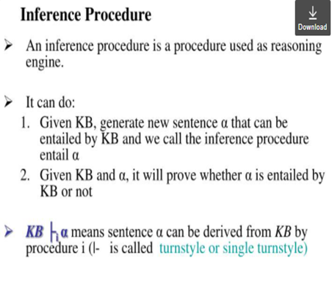

Slide 15
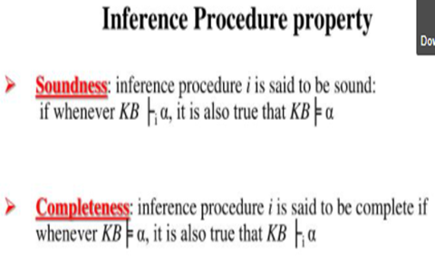

Slide 16
Rule of Inference in PL
There are a set of already identified sound inference rules
These are:
Modes Ponens or Implication elimination
AND Elimination
AND Introduction
OR Introduction
Double negation elimination
Unit resolution
Resolution

Slide 17
Normal Form of Logical Expressions
There are different standard forms of expressing PL statements.
Some inference procedure require their knowledge base to be in one of the normal forms to infer from it.
Hence, we need to convert that logical expression which are the source of knowledge into the appropriate forms

Slide 18
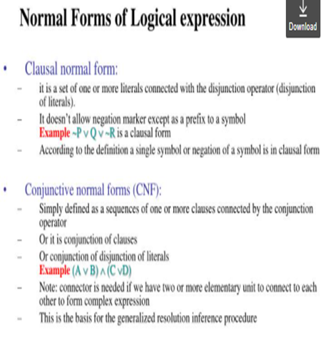

Slide 19
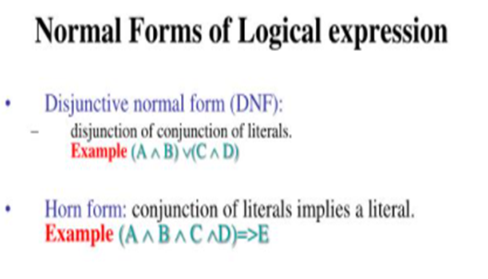

Slide 20

Inference Rules
Logical inference creates new sentences that logically follow from a set of sentences (KB).
An inference rule is sound if every sentence it produces when operating on a KB logically follows from the KB.
i.e., inference rule creates no contradictions.
An inference rule is complete if it can produce every expression that logically follows from (is entailed by) the K.
Note analogy to complete search algorithms.

Slide 21
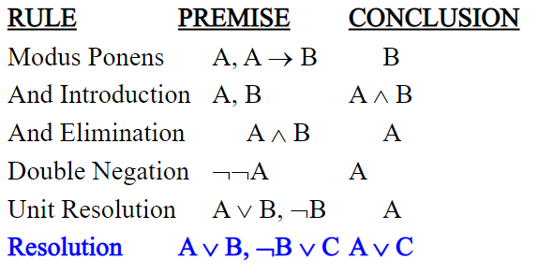
Sound rules of inferences
Here are some examples of sound rules of inference
Each can be shown to be sound using a truth table

Slide 22
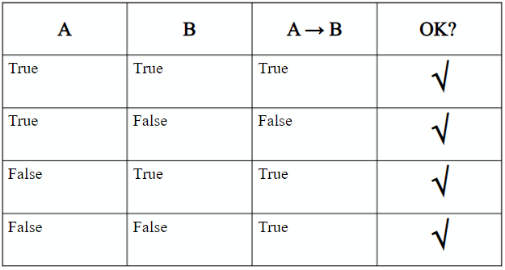
Soundness of Modus ponens

Slide 23
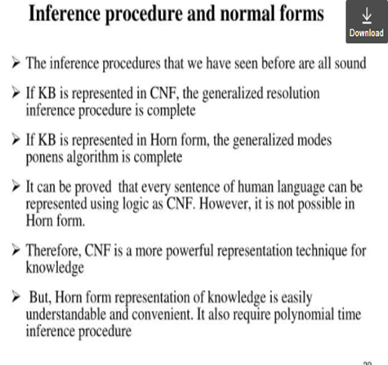

Slide 24
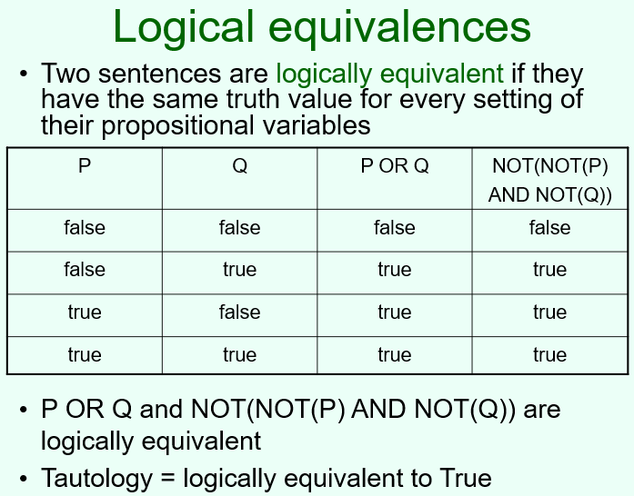

Slide 25
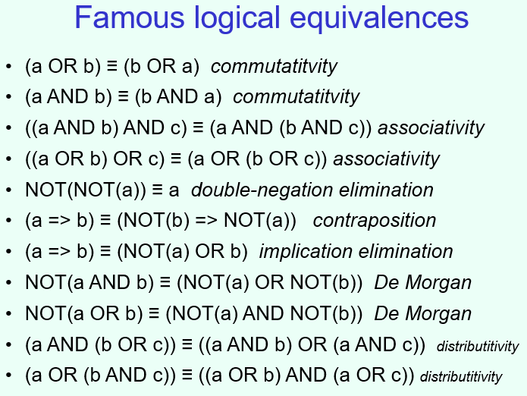

Slide 26
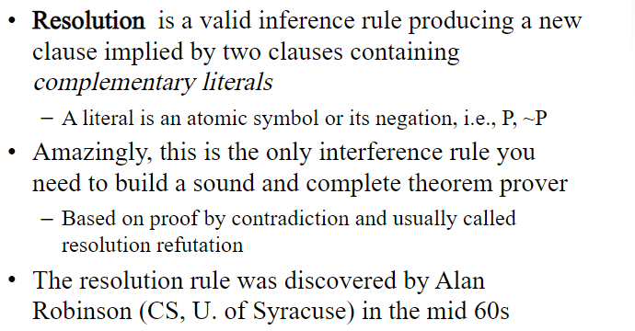
Resolution

Slide 27
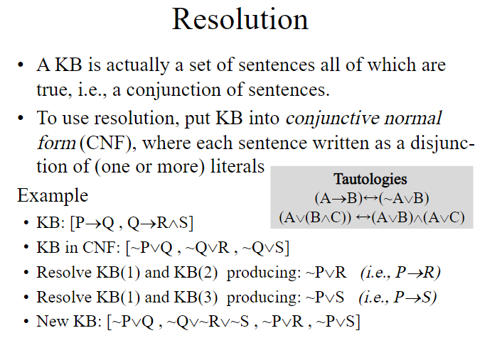

Slide 28
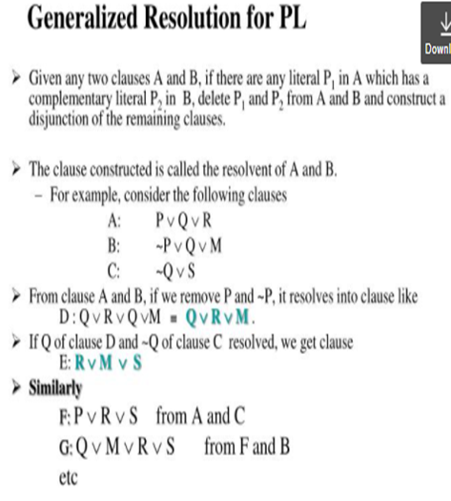

Slide 29
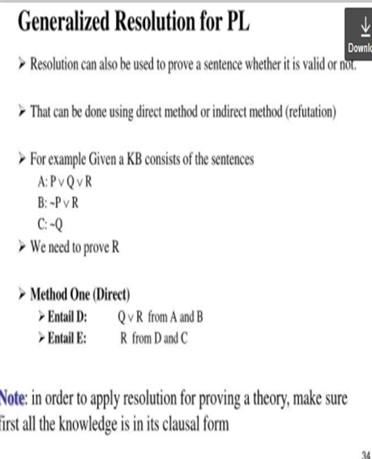

Slide 30
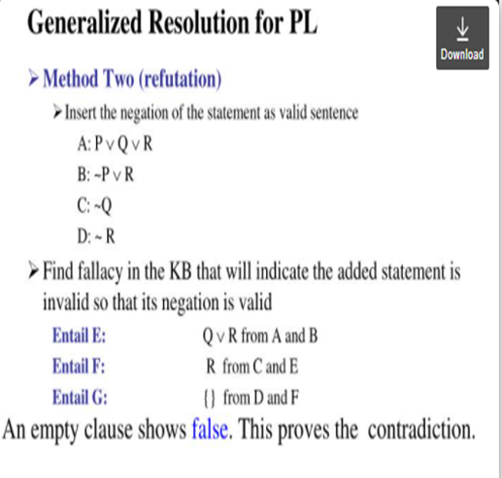

Slide 31
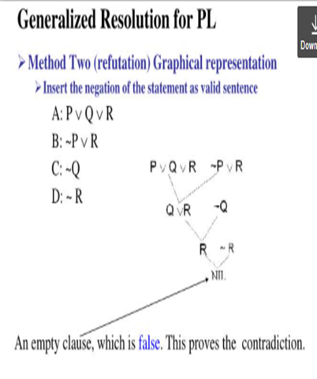

Slide 32
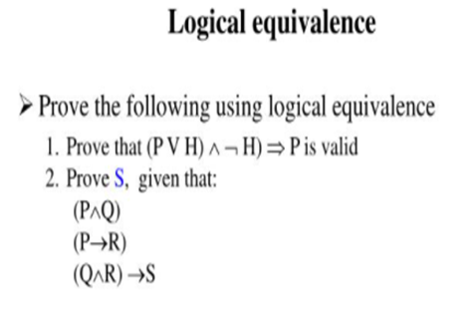
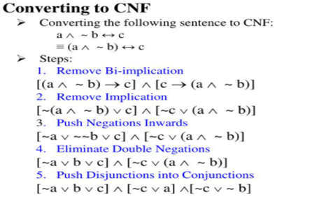

Slide 33
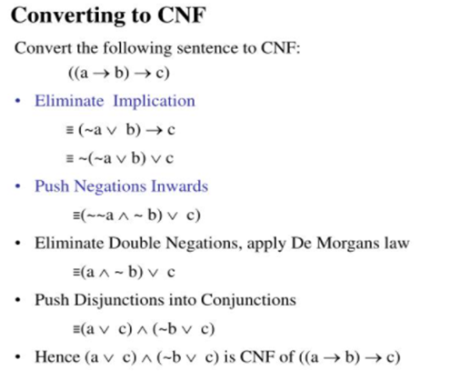
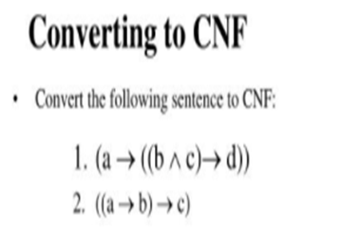

Slide 34
Wompus World in AI
The Wumpus world is an example used to illustrate the worth of a knowledge-based agent and to represent knowledge representation.
It was inspired by a video game Hunt the Wumpus by Gregory Yob in 1973.

Slide 35
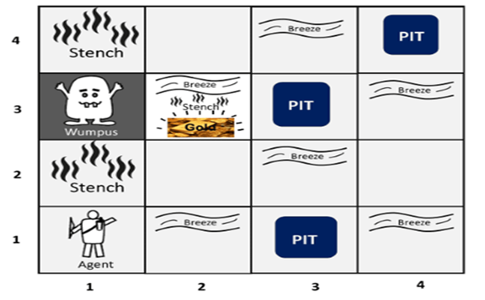
Wompus World cont.
Following is a sample diagram for representing the Wumpus world. It is showing some rooms with Pits, one room with Wumpus and one agent at (1, 1) square location of the world.
Note that Wumpus is STATIC and cannot move, the Agent

Slide 36

Wompus World cont.
Goal: Agent wants to move to the square which holds Gold, grab it and come back to the original square and release it there
Initially the agent can be at any square.
Environment
Square adjacent to Wumpus are smelly (stench)
Square adjacent to pit are breezy
Glitter if gold is in the same square
Shooting kills Wumpus if agent is facing it
Shooting uses up the only arrow
Grabbing picks up gold if in same square
Releasing drops the gold in same square

Slide 37
PEAS Description of Wumpus World:
To explain the Wumpus world we have given PEAS description as below:
Performance measure:
+1000 reward points if the agent comes out of the cave with the gold.
-1000 points penalty for being eaten by the Wumpus or falling into the pit.
-1 for each action, and -10 for using an arrow.
The game ends if either agent dies or came out of the cave.
Environment:
A 4*4 grid of rooms.
The agent initially in room square [1, 1], facing toward the right.
Location of Wumpus and gold are chosen randomly except the first square [1,1].
Each square of the cave can be a pit with probability 0.2 except the first square.

Slide 38
PEAS cont.
Actuators:
Left turn,
Right turn
Move forward
Grab
Release
Shoot.
Sensors:
The agent will perceive the stench if he is in the room adjacent to the Wumpus. (Not diagonally).
The agent will perceive breeze if he is in the room directly adjacent to the Pit.
The agent will perceive the glitter in the room where the gold is present.
The agent will perceive the bump if he walks into a wall.
When the Wumpus is shot, it emits a horrible scream which can be perceived anywhere in the cave.
These percepts can be represented as five element list, in which we will have different indicators for each sensor.
Example if agent perceives stench, breeze, but no glitter, no bump, and no scream then it can be represented as:
[Stench, Breeze, None, None, None].

Slide 39
Wumpus World Properties
Partially observable: The Wumpus world is partially observable because the agent can only perceive the close environment such as an adjacent room.
Deterministic: It is deterministic, as the result and outcome of the world are already known.
Sequential: The order is important, so it is sequential.
Static: It is static as Wumpus, and Pits are not moving.
Discrete: The environment is discrete.
One agent: The environment is a single agent as we have one agent only and Wumpus is not considered as an agent.

Slide 40
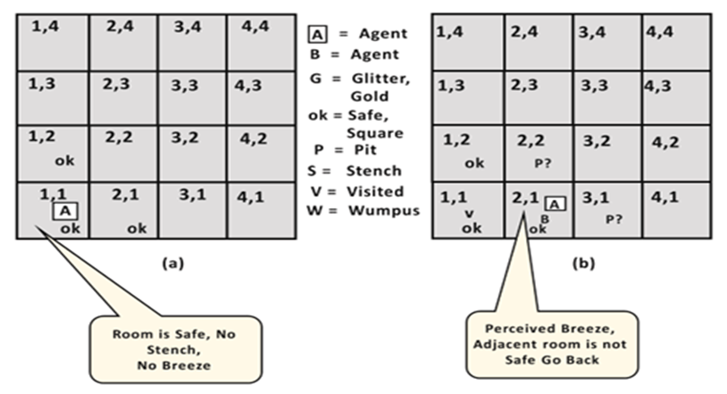
Exploring the Wumpus world:
Now we will explore the Wumpus world and will determine how the agent will find its goal by applying logical reasoning.
Agent's First step:
Initially, the agent is in the first room or on the square [1,1], and we already know that this room is safe for the agent, so to represent on the below diagram (a) that room is safe we will add symbol OK. Symbol A is used to represent agent, symbol B for the breeze, G for Glitter or gold, V for the visited room, P for pits, W for Wumpus.
At Room [1,1] agent does not feel any breeze or any Stench which means the adjacent squares are also OK.

Slide 41
Agent's second Step:
Now agent needs to move forward, so it will either move to [1, 2], or [2,1]. Let's suppose agent moves to the room [2, 1], at this room agent perceives some breeze which means Pit is around this room. The pit can be in [3, 1], or [2,2], so we will add symbol P? to say that, is this Pit room?
Now agent will stop and think and will not make any harmful move. The agent will go back to the [1, 1] room. The room [1,1], and [2,1] are visited by the agent, so we will use symbol V to represent the visited squares.

Slide 42
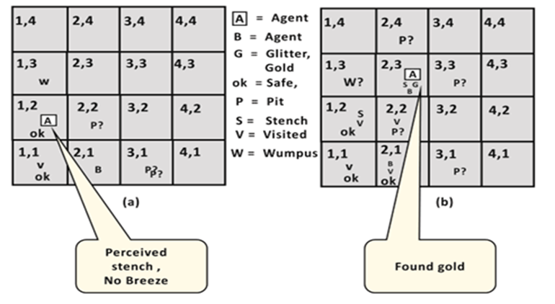
Agent's third step:
At the third step, now agent will move to the room [1,2] which is OK.
In the room [1,2] agent perceives a stench which means there must be a Wumpus nearby.
But Wumpus cannot be in the room [1,1] as by rules of the game, and not in [2,2] (Agent had not detected any stench when he was at [2,1]).
Therefore, agent infers that Wumpus is in the room [1,3], and in current state, there is no breeze which means in [2,2] there is no Pit and no Wumpus.
So, it is safe, and we will mark it OK, and the agent moves further in [2,2].

Slide 43
Agent's fourth step:
At room [2,2], here no stench and no breezes present so let's suppose agent decides to move to [2,3]. At room [2,3] agent perceives glitter, so it should grab the gold and climb out of the cave.

